Slide 1

Predicting Credit Card Default Using Machine Learning
IE 7300 Statistical Learning for Engineering
Team Members:
Swetha Ganesh,
Himabindu Peramala,
Francisco Chavez,
Xinyue Niu,
Xueshi Bai

Slide 2
Abstract
Credit card default prediction is crucial in financial risk management.
Utilized dataset from UCI repository (30,000 records).
Models used: Logistic Regression, Decision Tree, Random Forest, SVM,AdaBoost.
Performance evaluated using accuracy, precision, recall, F1-score, ROC-AUC.
Tools: GitHub (version control), Google Colab (development).

Slide 3

Introduction
• Credit cards are essential in modern finance, but defaults are risky for banks.
• Traditional models are limited in capturing data complexity.
• ML models offer adaptability to predict defaults.
• Goal: Predict if a client will default next month using ML techniques.

Slide 4
Dataset Description
30,000 clients, 24 features (23 input, 1 target).
Demographics: SEX, AGE, EDUCATION, MARRIAGE.
Financial data: LIMIT_BAL, PAY_0 to PAY_6, BILL_AMT, PAY_AMT.
Target: Default payment next month (1/0).
No missing values, ID removed, categorical variables encoded.

Slide 5
Preprocessing & Feature Engineering
ID column removed due to no predictive value.
One-hot encoding applied to categorical variables: SEX, EDUCATION, MARRIAGE.
StandardScaler used to scale numerical features (e.g., LIMIT_BAL, AGE).
Handled class imbalance with techniques like SMOTE and RandomOverSampler.
Applied Recursive Feature Elimination (RFE) and Sequential Feature Selection (SFS).
Feature engineering included creating ratios like PAY_AMT / BILL_AMT.

Slide 6
Exploratory Data Analysis
No missing/duplicate values; ID dropped.
78% non-default, 22% default (moderate imbalance).
Higher default rates among males, singles, less educated.
PAY_0 to PAY_6 are strong predictors.
Strong correlation in financial variables; multicollinearity addressed.

Slide 7
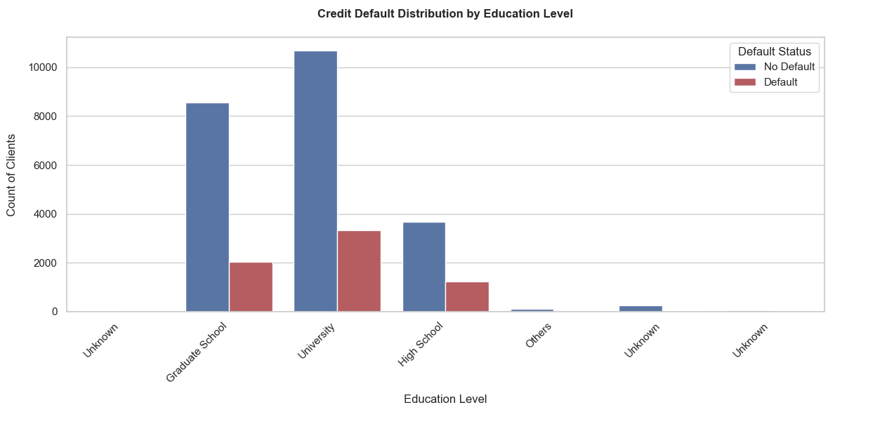
EDA

Slide 8
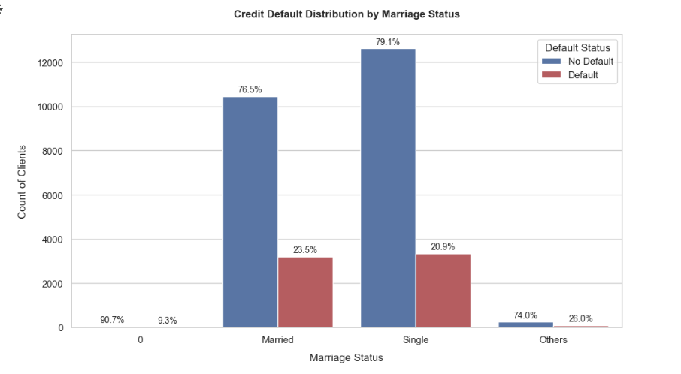
EDA

Slide 9
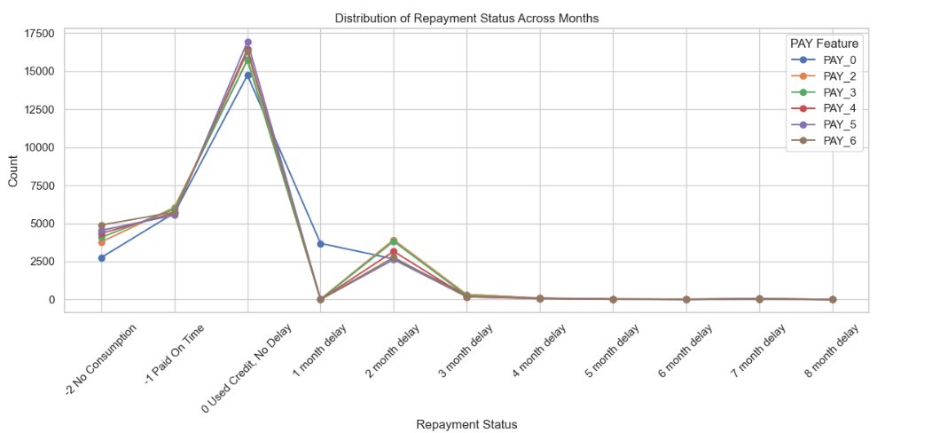
EDA

Slide 10
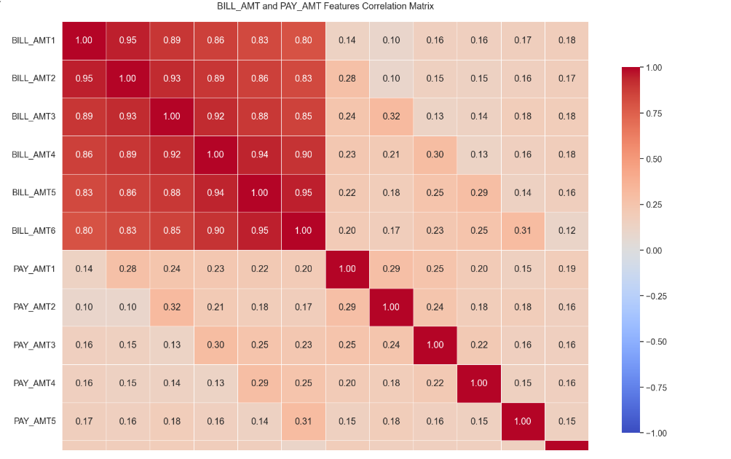
EDA

Slide 11
Models Overview
Logistic Regression (baseline, interpretable).
Decision Tree (non-linear splits).
Random Forest (ensemble, high accuracy).
AdaBoost (focuses on hard cases).
Neural Network (non-linear pattern learning).
Naïve Bayes (probabilistic, fast).
SVM (margin-based, kernel trick).

Slide 12
Logistic Regression
Linear classifier modeling log-odds using sigmoid function.
Loss: Binary cross-entropy; Optimized using gradient descent.
Accuracy: 70%, Precision C1: 0.48, Recall C1: 0.67, F1: 0.56, AUC: 0.74
Strength: Interpretability Limitation: Too simple

Slide 13
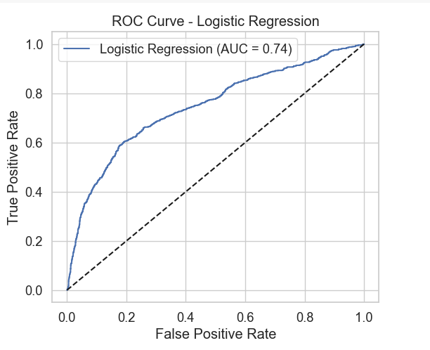

Slide 14
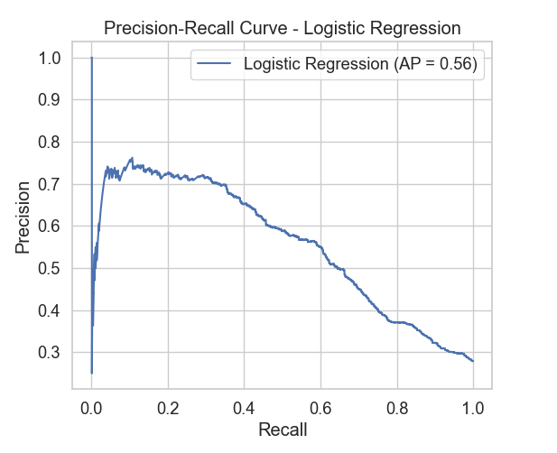

Slide 15
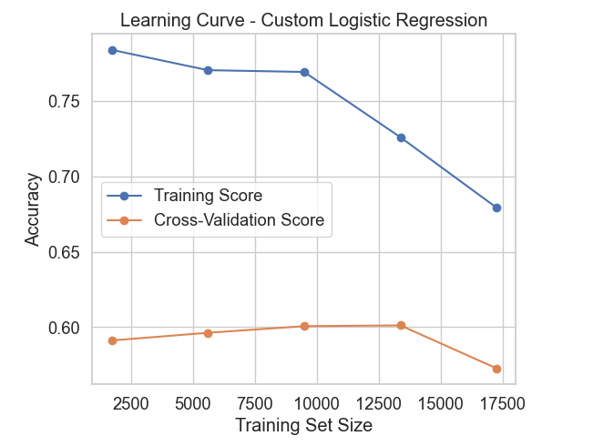

Slide 16

Naive Bayes
Probabilistic model using Bayes’ Theorem; assumes feature independence.
Accuracy: 65%, Precision: 0.72, Recall: 0.65, F1: 0.67, AUC: 0.73.
Strength: Fast, simple; Limitation: Assumption of independence.

Slide 17
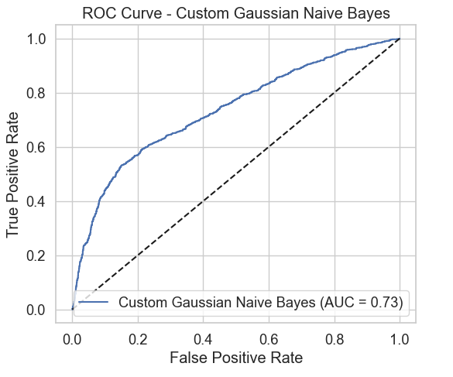

Slide 18
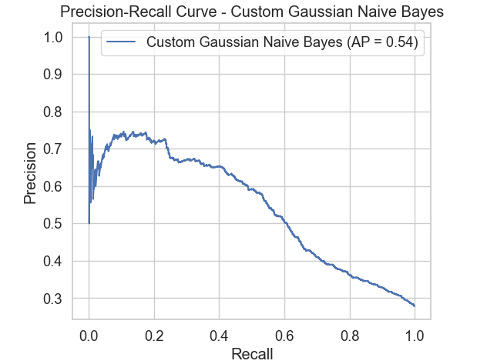

Slide 19
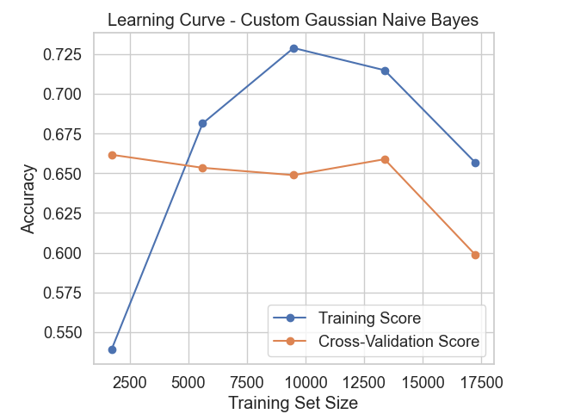

Slide 20
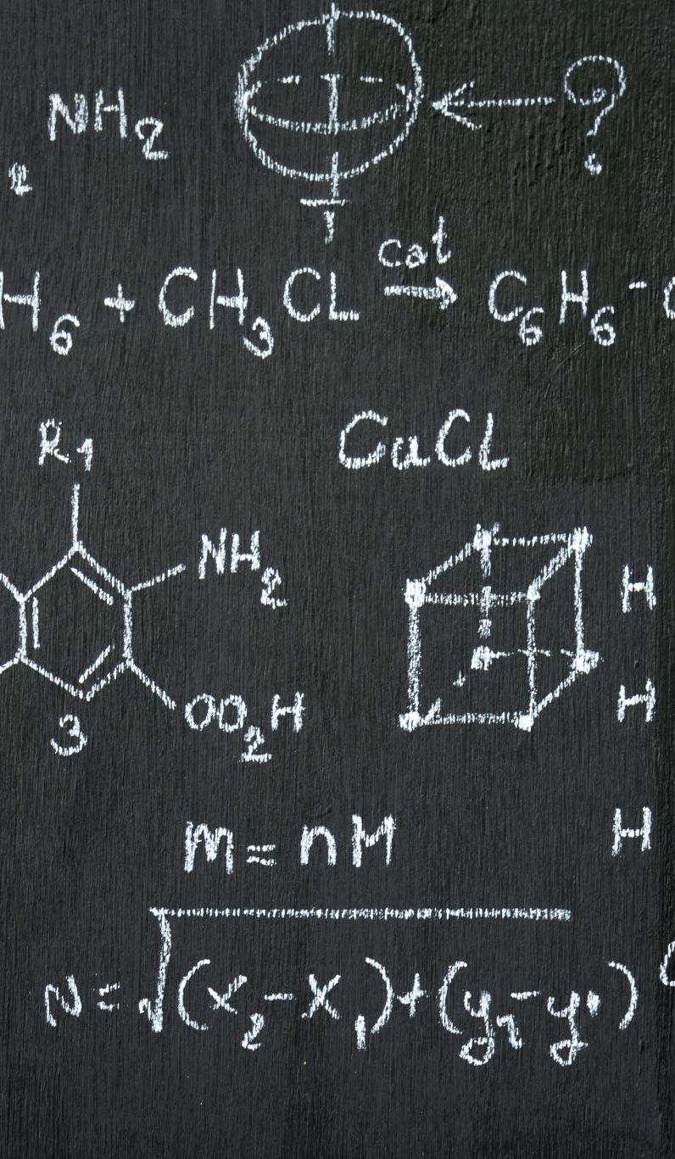
Neural Network
MLP with hidden layers using backpropagation and sigmoid/ReLU.
Accuracy: 73%, Precision: 0.75, Recall: 0.73, F1: 0.74, AUC: 0.76.
Strength: Learns complex patterns; Limitation: Less interpretable.

Slide 21
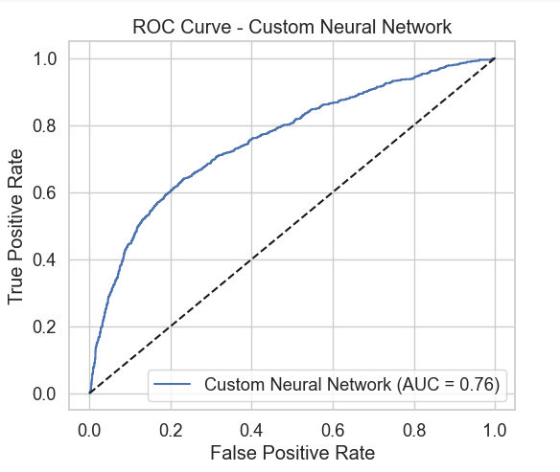

Slide 22
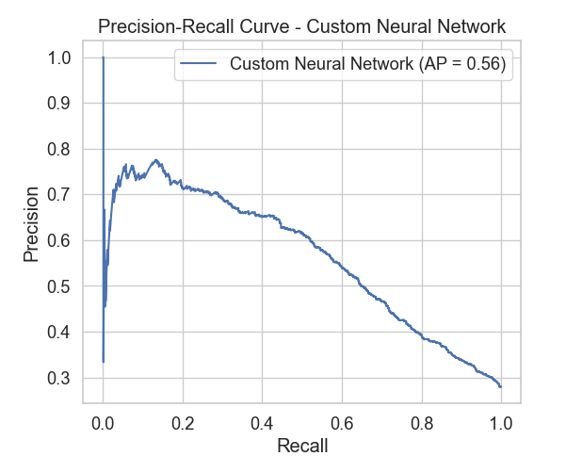

Slide 23
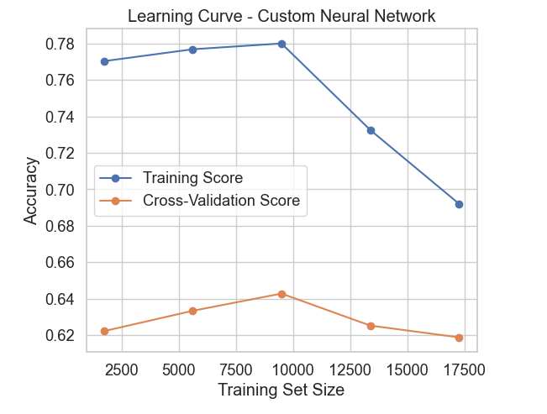

Slide 24

Decision Tree
Splits data using Gini or Entropy to form a hierarchy of decisions.
Accuracy: 72%, Precision: 0.73, Recall: 0.72, F1: 0.73, AUC: 0.71.
Strength: Easy to interpret; Limitation: Overfitting risk.

Slide 25
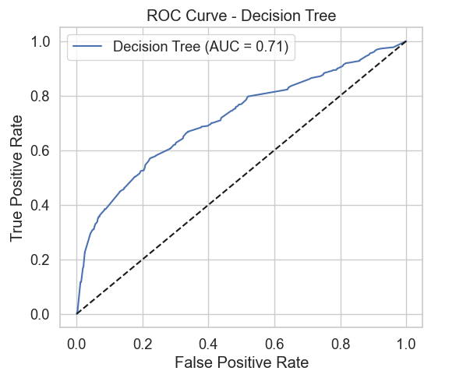

Slide 26
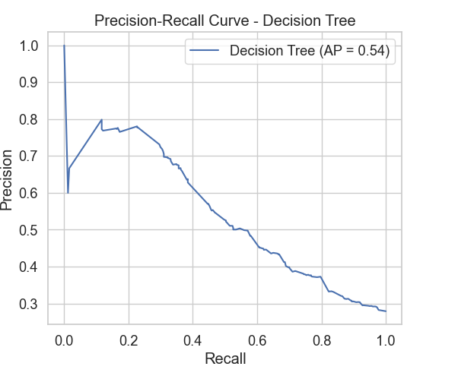

Slide 27
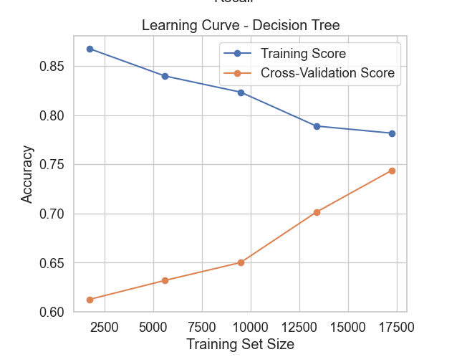

Slide 28
Random Forest
Ensemble of Decision Trees using bagging and random feature selection.
Accuracy: 76%, Precision: 0.77, Recall: 0.76, F1: 0.76, AUC: 0.78.
Strength: High performance, reduces variance.

Slide 29
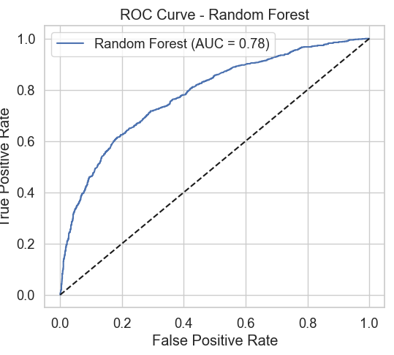

Slide 30
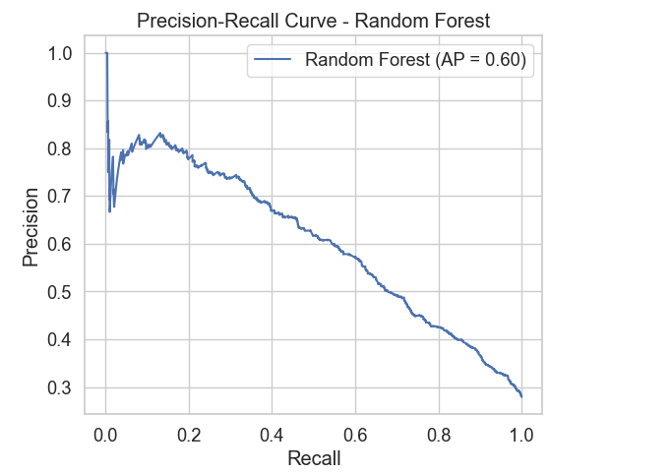

Slide 31
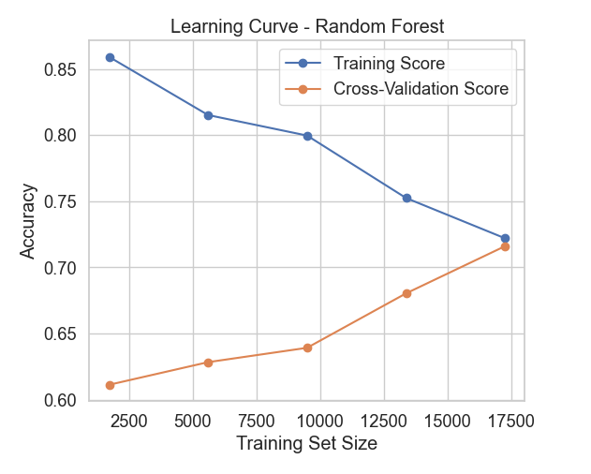

Slide 32
AdaBoost
Boosting method that builds learners focusing on misclassified samples.
Accuracy: 76%, Precision: 0.76, Recall: 0.76, F1: 0.76, AUC: 0.78.
Strength: Focus on hard cases; Limitation: Slightly lower recall.

Slide 33
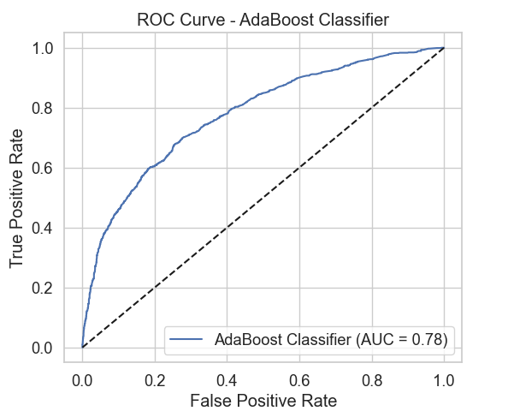

Slide 34
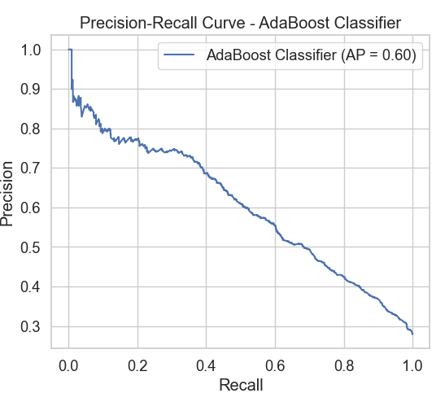

Slide 35
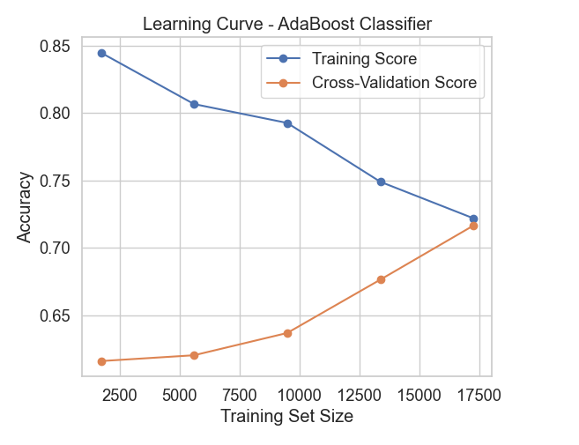

Slide 36
Model Comparison
Random Forest performed best overall.
Logistic Regression offered interpretability but lower recall.
Neural Network captured non-linear patterns.
AdaBoost handled hard samples effectively.

Slide 37
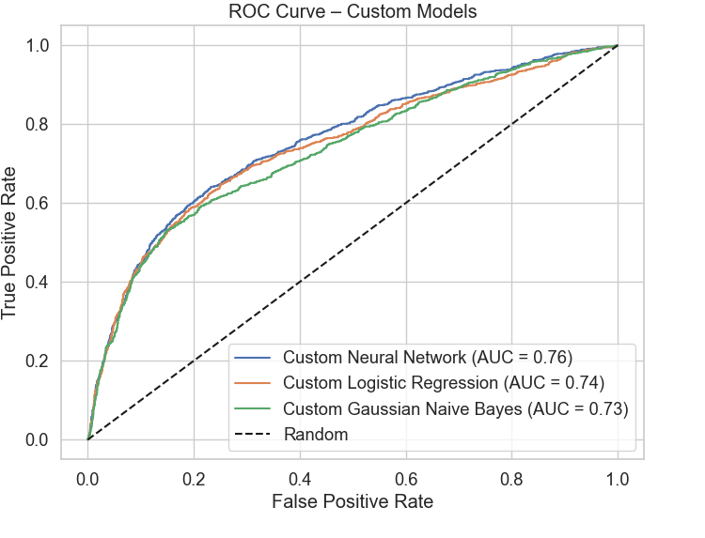

Slide 38
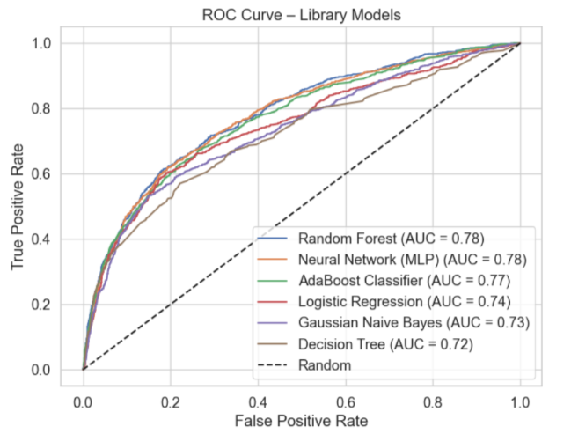

Slide 39
Summary: Scratch vs Library Models
Scratch Models Summary:
Neural Network: Best overall, captured complex patterns.
Logistic Regression: High recall, stable but linear.
Naive Bayes: Best recall, prone to false positives.
Library Models Summary:
Random Forest: Top performer in AUC and stability.
AdaBoost: Strong recall, handles hard cases well.
SVM & MLP: Balanced results with good AUC scores.

Slide 40
Evaluation Metrics Used
Accuracy: Overall correctness.
Precision: Focus on positive predictions.
Recall: Ability to catch all actual positives.
F1-Score: Balance of precision and recall.
ROC-AUC: Discrimination capacity between classes.

Slide 41
Visualization: ROC Curves
• ROC curves plotted for all models.
• Random Forest, SVM showed highest AUC values.
• Logistic Regression curve close to diagonal.

Slide 42

Visualization: Confusion Matrices
• Showed balance of TP, FP, FN, TN across models.
• Random Forest and SVM had lowest false negatives.
• Naive Bayes showed many false negatives.

Slide 43
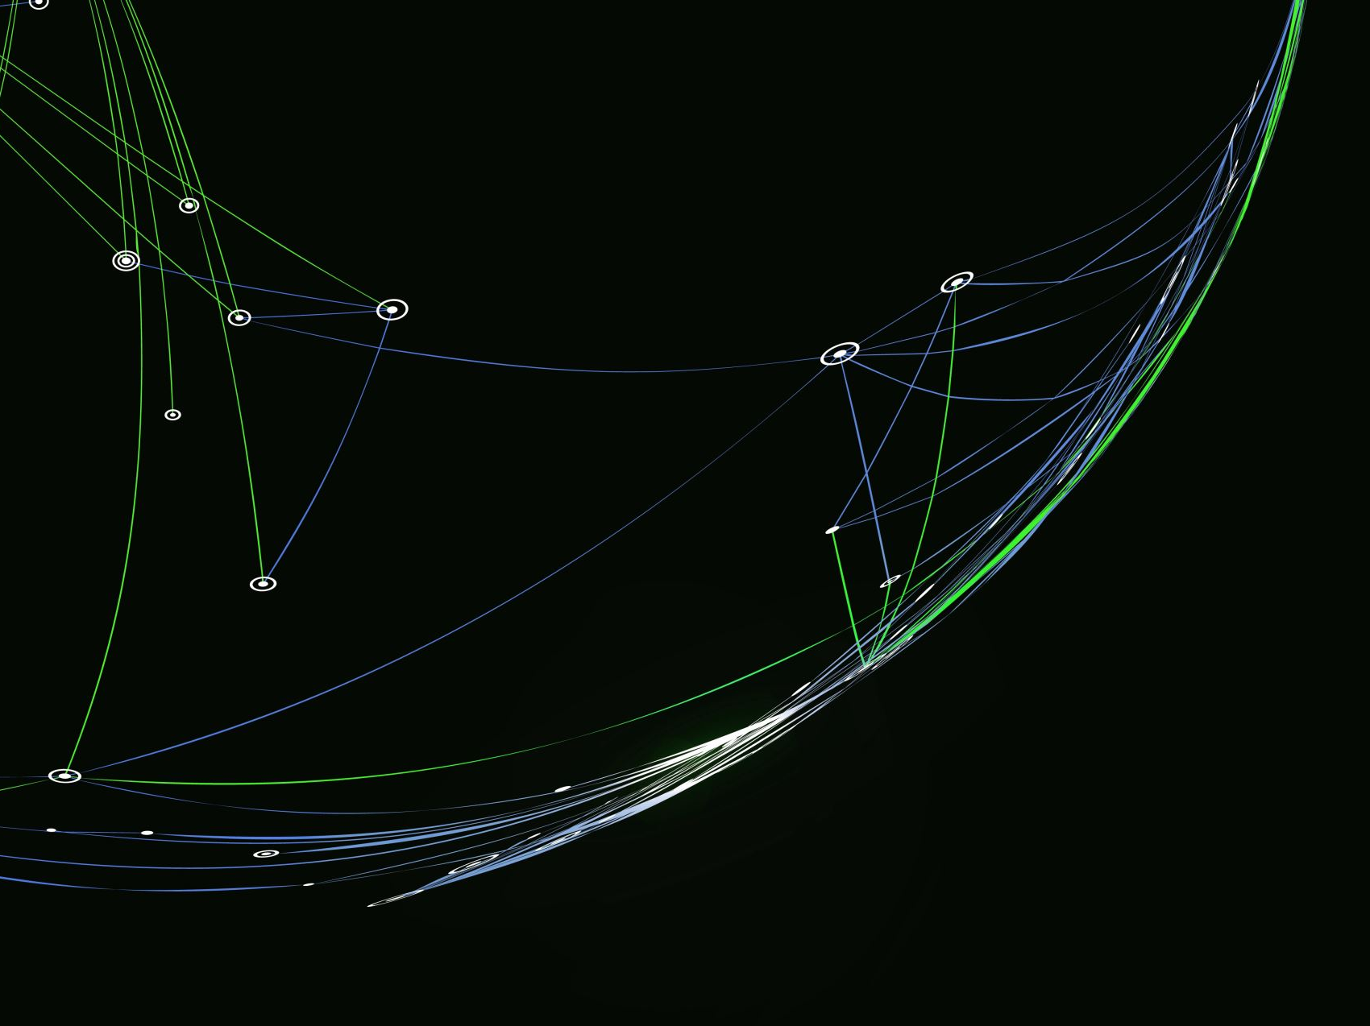
Visualization: Learning Curves
• Logistic Regression showed early convergence.
• Neural Network had more training capacity.
• Random Forest showed stable performance.

Slide 44
Conclusion
Compared multiple ML models using library and scratch implementations.
Neural Network was best-performing among scratch models:
Accuracy: ~72.78%, ROC AUC: 0.7572, F1-score: 0.5683 (defaulters)
Random Forest and AdaBoost performed best among library models.
Scratch models successfully replicated performance with solid generalization.
Strong learning outcomes in understanding and implementing core ML concepts.

Slide 45
Future Work
• Explore time-series modeling for sequential data.
• Implement explainable AI tools (e.g., SHAP).
• Try deep learning models with temporal attention.
• Investigate deployment for real-time scoring.

